Slide 1
Merchant Clustering and Churn Analysis
David Tan
March 8, 2022

Slide 2
Problem 1: Merchant Segmentation
We want to understand merchants payment activity to try
to infer their types of business.
Data:
2-year period (2033 - 2034)
Random sample of future merchants using Stripe
If the merchant stops processing with Stripe, they would no longer appear.
Goal:
Identify different kinds of businesses in the sample
Generate assignments for each merchant

Slide 3
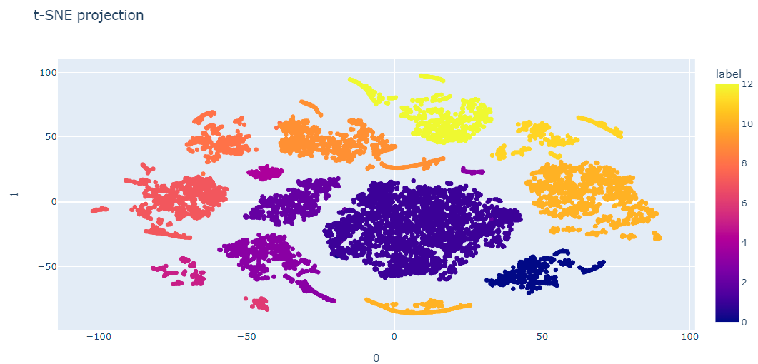
Problem 1: Summary & Conclusion
Based on K-means clustering, all merchants are
assigned into 13 different groups (labeled from 0 to 12).
The t-SNE plot is a 2D visualization to visualize our cluster assignment. Merchants seem to be well segmented into 13 groups.

Slide 4
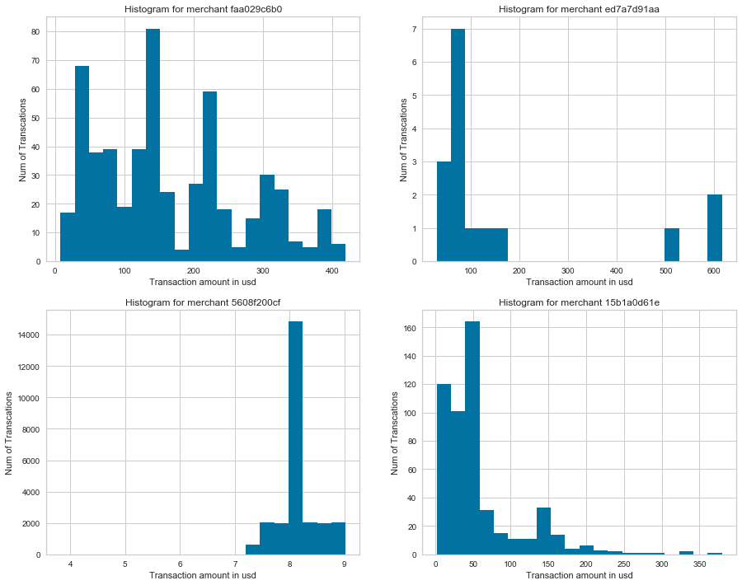
Problem 1: Exploratory Data Analysis
The raw data has 1,513,719 rows and 3 columns
No missing values
Number of merchant: 14,351
Histograms show that transaction distributions are skewed (not symmetrical).

Slide 5
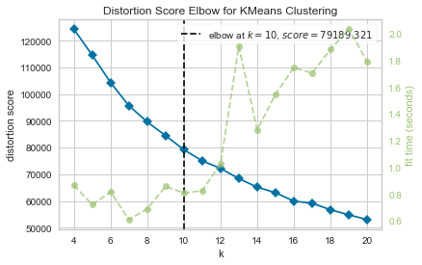
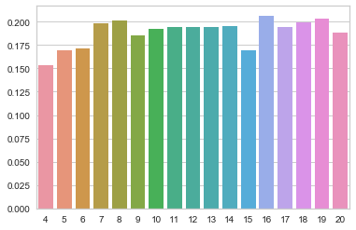
Problem 1: K-Means Clustering
We choose K-means clustering to partition merchants into k clusters in which each cluster represents a type of business.
Based on Elbow method and Sihouette scores, we choose k = 16.

Slide 6
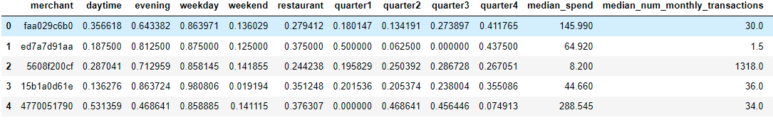
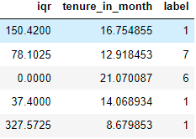
Problem 1: K-Means Clustering
After centroids quality check and K-means re-fit, all merchants were assigned into 13 groups based on their similarity.
The final results in csv format. Column ‘label’ indicates each merchant’s assignment.

Slide 7
Problem 2: Churn Prediction
Sometimes a merchant may stop processing with the online payment company, which we call churn. We are interested in identifying and predicting churn.
Goal:
a) come up with a concrete definition for churn
b) identify merchants that have already churned in the dataset
c) build a model to predict which active merchants are most likely to churn in the near future.

Slide 8
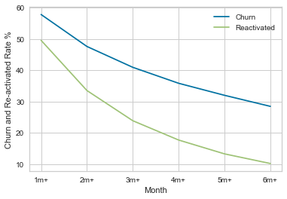
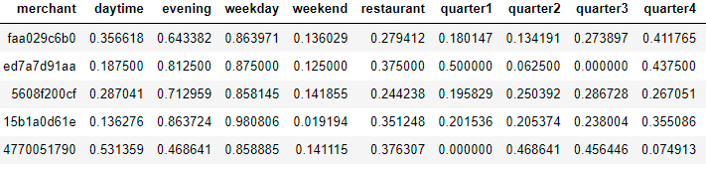
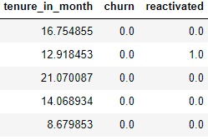
Problem 2: Summary & Conclusion
We define churn as a merchant who has at least 4 months or more no activity after the last transaction.
We labelled merchants with 4m+ no transaction since the last transaction as churn merchants, others no-churn merchants. Column “churn” is a binary variable indicating churn merchants.

Slide 9
Problem 2: Churn Prediction Model
Our final model is based on LightGBM and it is chosen by the
maximum accuracy score and F1 Score among all candidate models.
With exploratory data analysis, we inherited features developed from feature generation in part one. It was concluded that there were no missing observations in the dataset. However, we've seen outliers from the boxplots.
In total we developed 8 ML models. Accuracy score, Precision, Recall, F1-score, classification report and confusion matrix were all generated. We also evaluated each model by 5-fold cross validation.

Slide 10
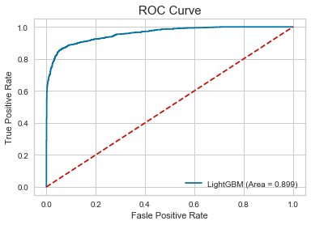
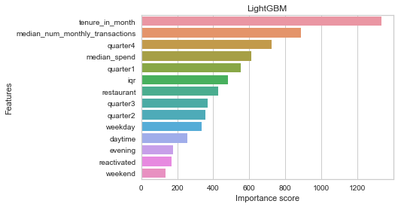
Problem 2: LightGBM Model Results
The model based on LightGBM hyperparameter optimization became the winning model with the maximum AUC (0.898542). This means our model can predict 89.9% accurate churn cases.
Features tenure_in_month, median_num_monthly_transactions, quarter 4 and median_spend are most relevant to churn. Our business team need to pay particular attention to those.

